Slide 1
A phylogenomic investigation of Scutellaria reveals distinct patterns in flavonoid diversity
Bryce Askey¹, Yeong Hun Song¹, Yoonkyung Lee², Ru Dai¹, Tong Geon Lee^{1,3,4}, Sangtae Kim², and Jeongim Kim^{1,3}
¹Horticultural Sciences Department, University of Florida, Gainesville, FL, USA
²Department of Biology, Sungshin Women’s University, Seoul, Republic of Korea
³Plant Molecular and Cellular Biology Graduate Program, University of Florida, Gainesville, FL, USA
⁴Gulf Coast Research and Education Center, University of Florida, Wimauma, FL, USA

Slide 2
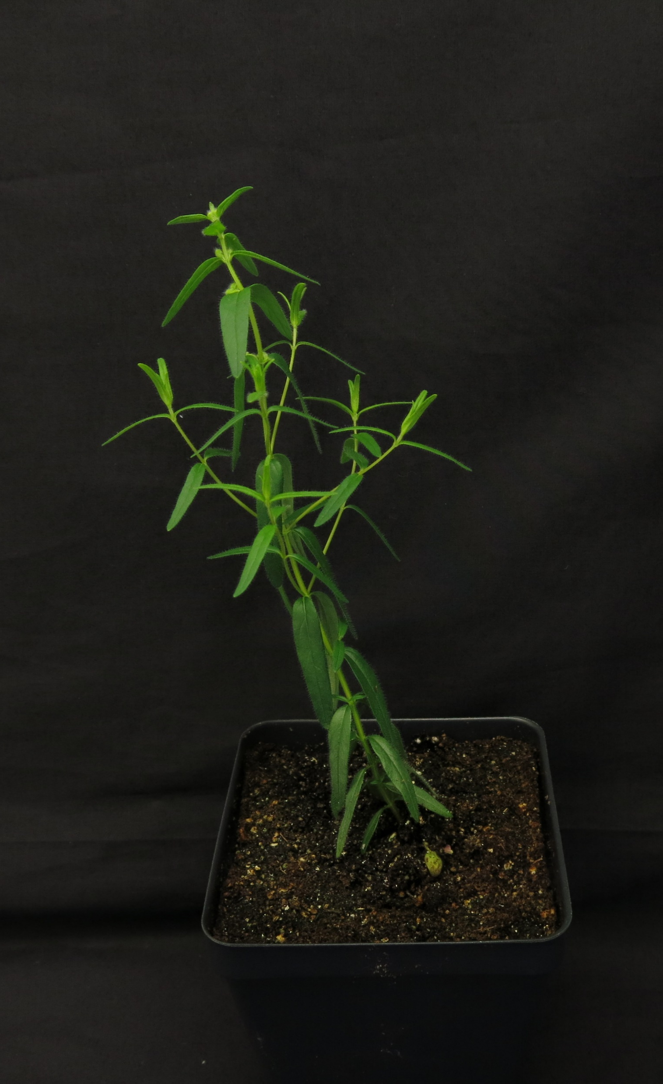
Introduction
Scutellaria baicalensis is a well-studied medicinal plant
Root extracts used in Eastern medicine
Possesses unique flavonoid biosynthetic pathway
Reference genome published in 2019
However, Scutellaria contains >470 other species
Many not well studied/not studied at all
Goal: assay a diverse set of Scutellaria species to provide insight into the evolutionary history and medicinal relevance of the genus

Slide 3
Table 1. Information about Scutellaria tissue samples used in study
Species | Organ | Condition | Source
S. baicalensis | L, S, R | Fresh | Seeds from …
… | … | … | …

Slide 4
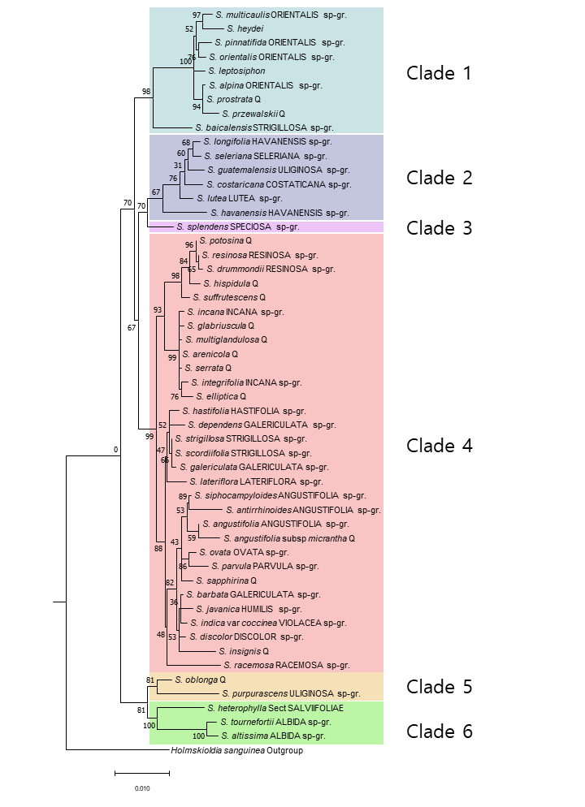
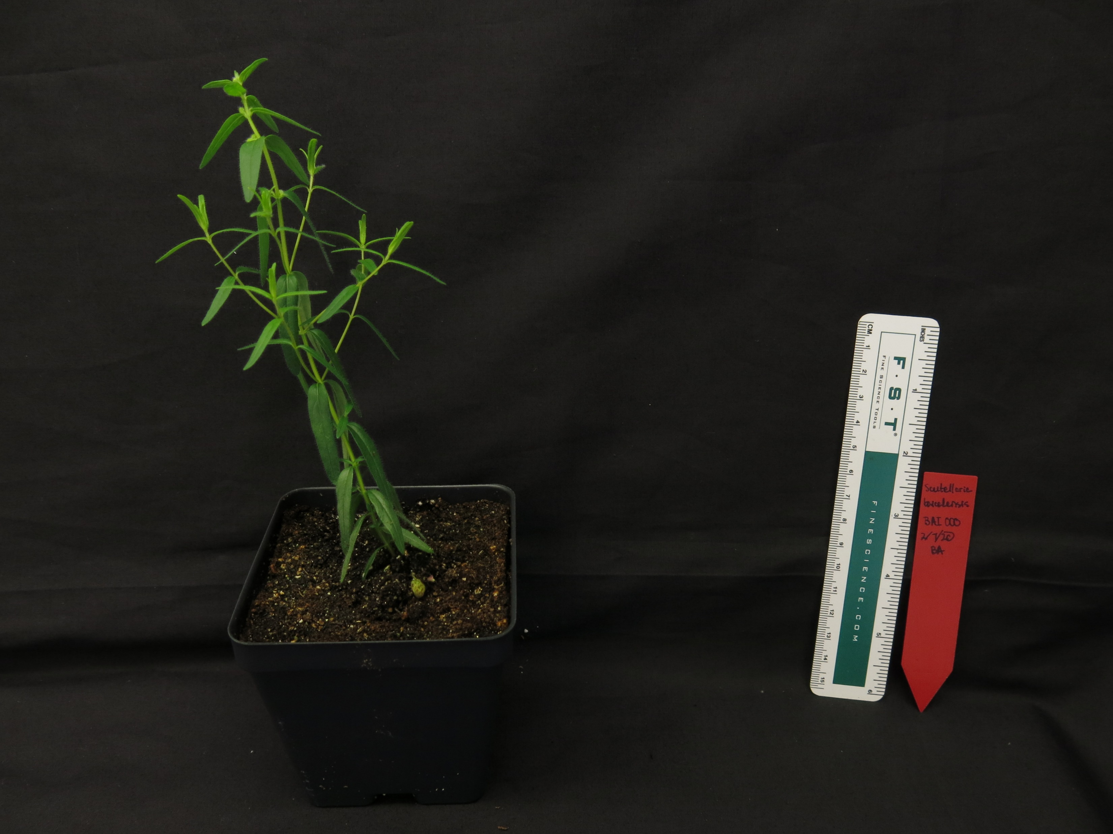
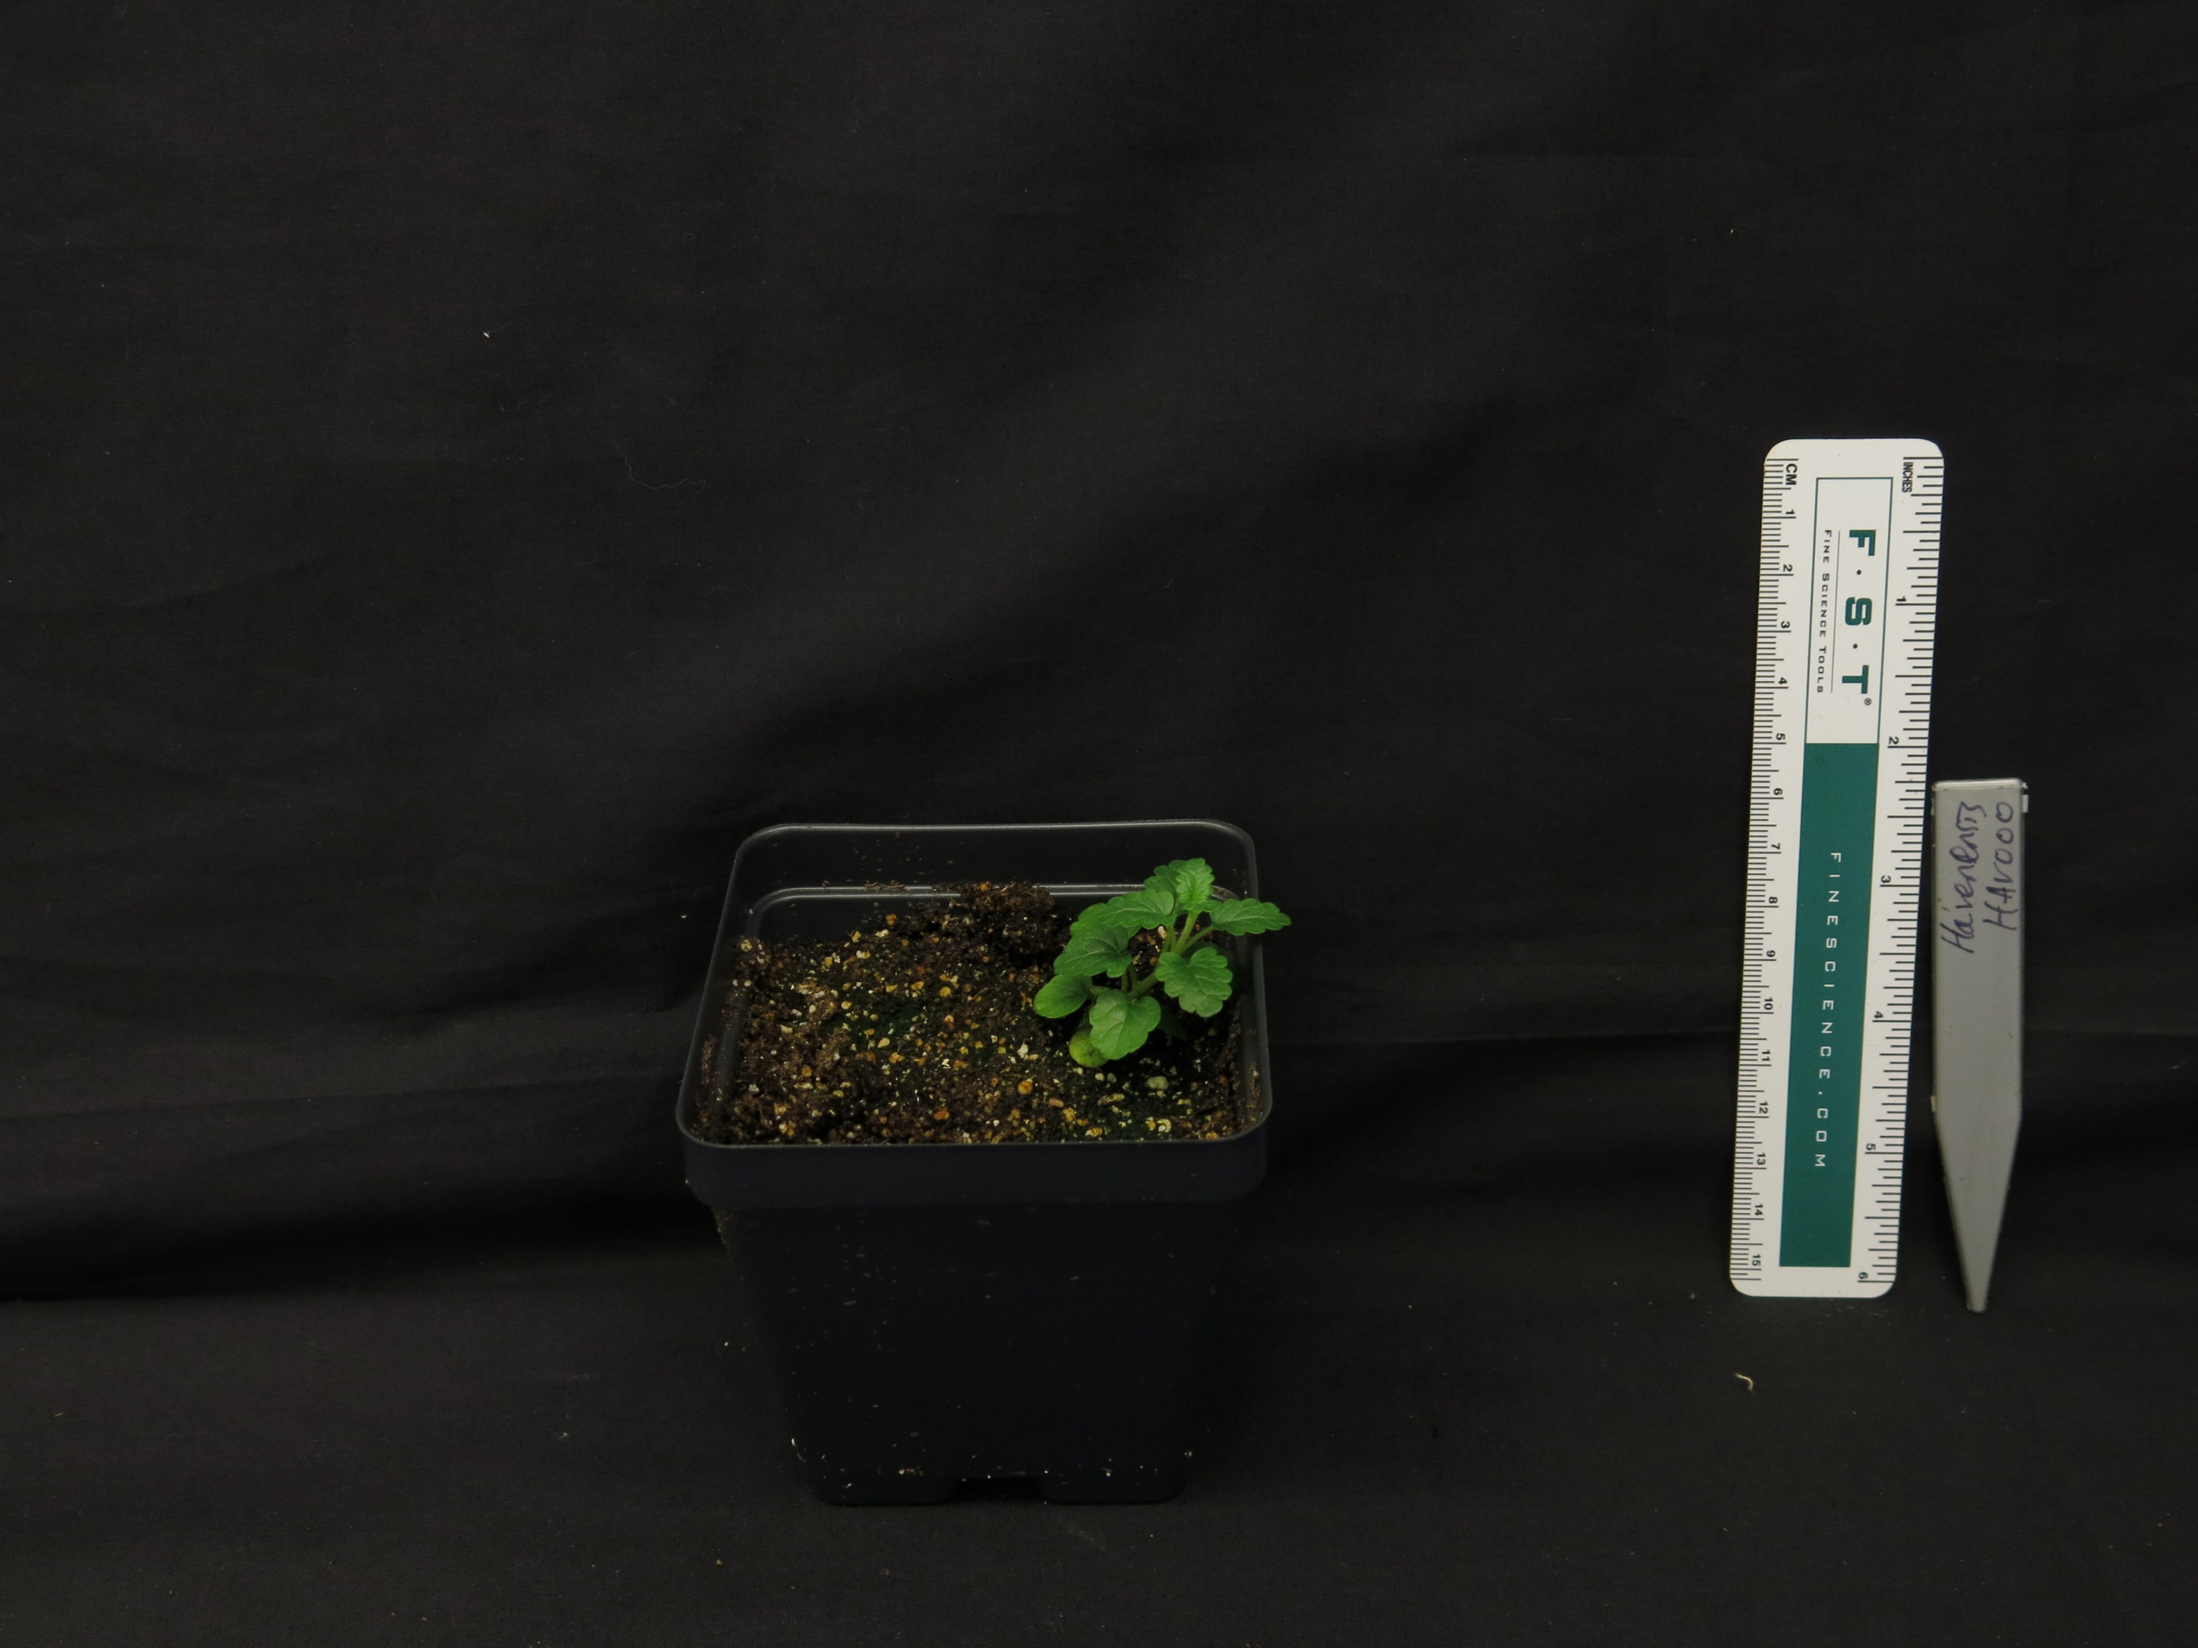
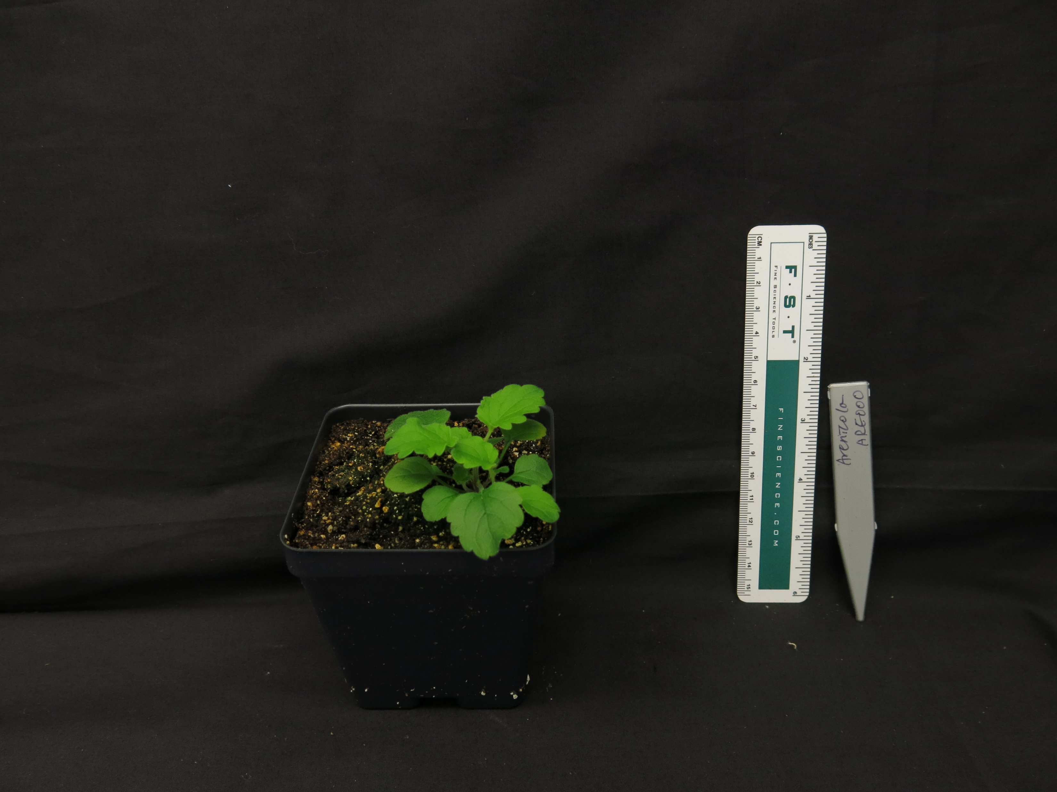
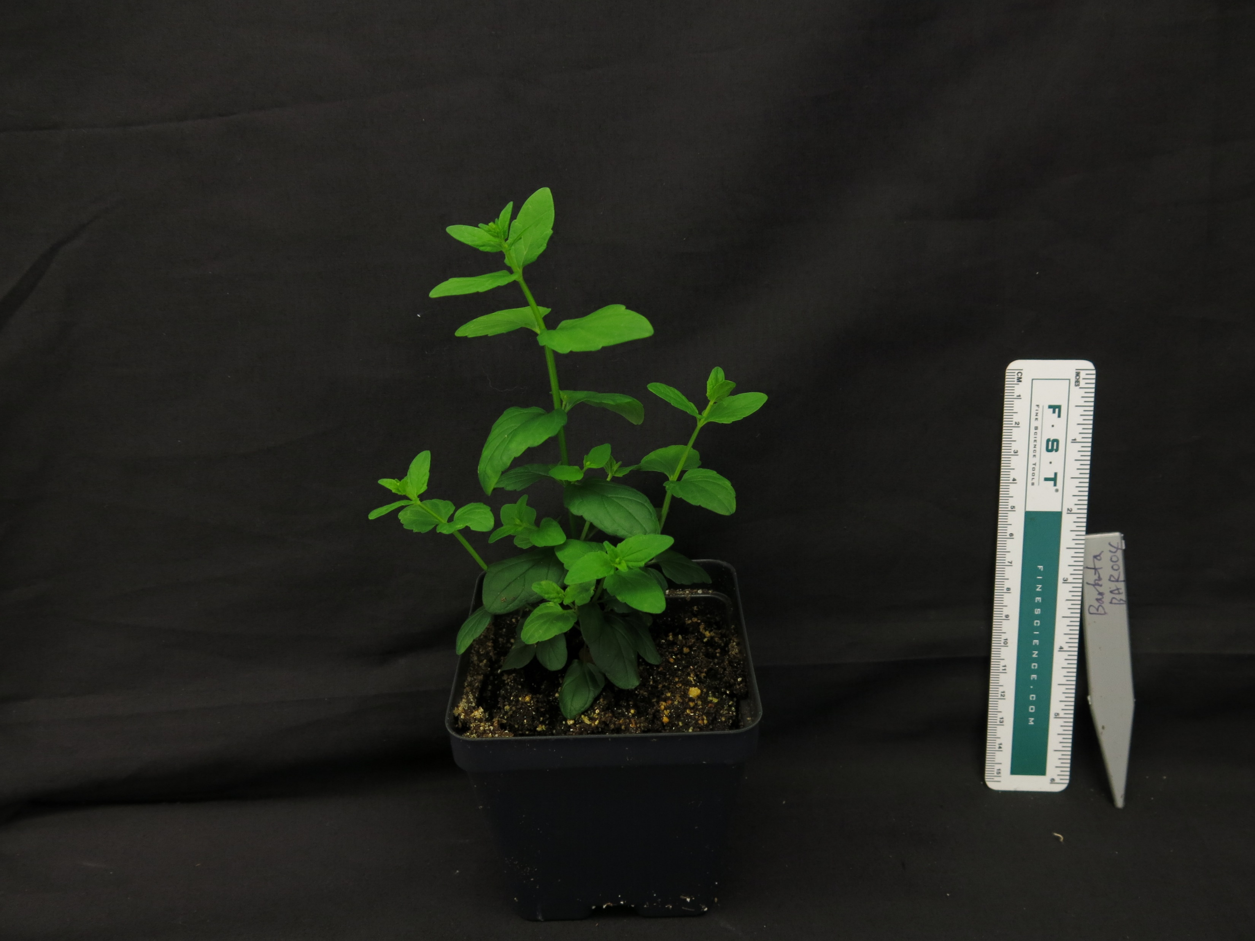
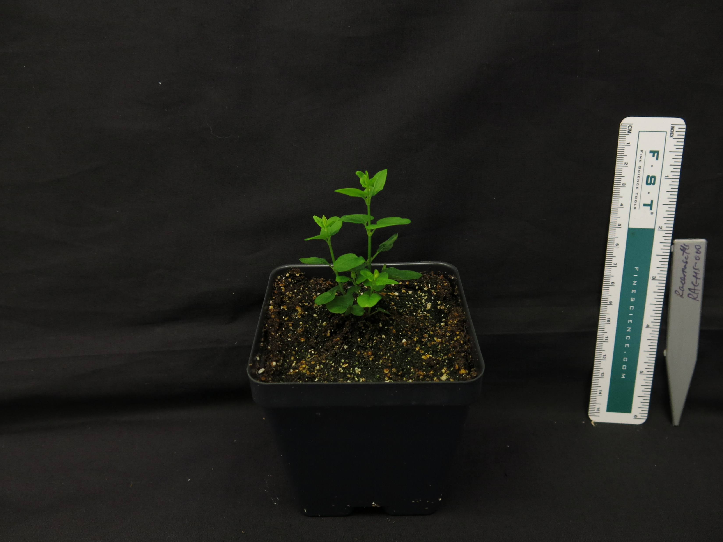
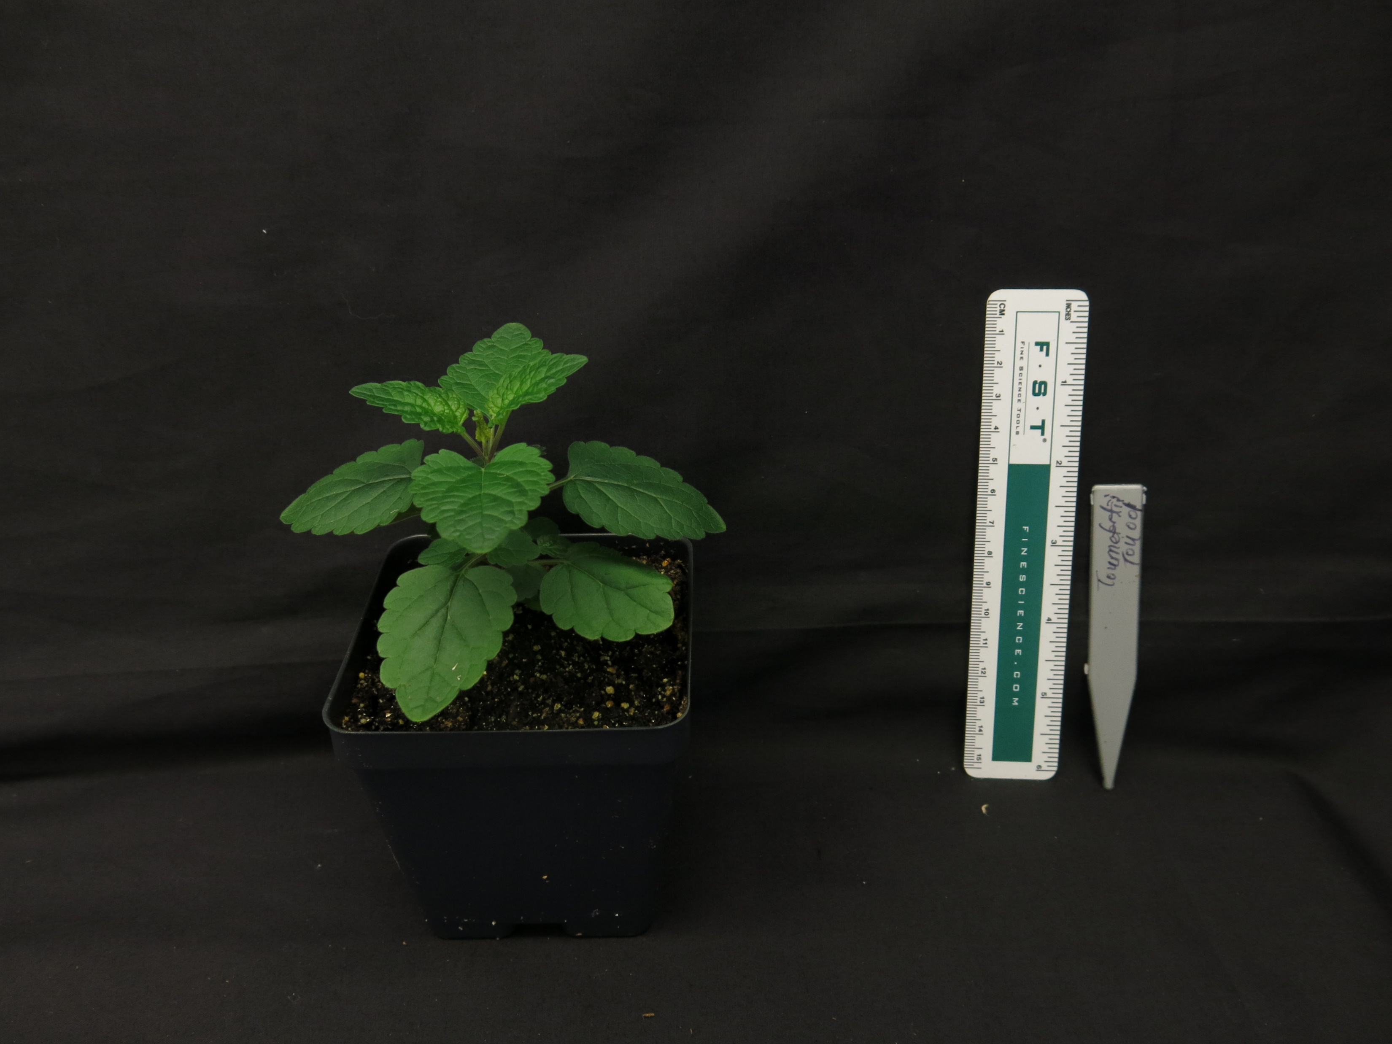
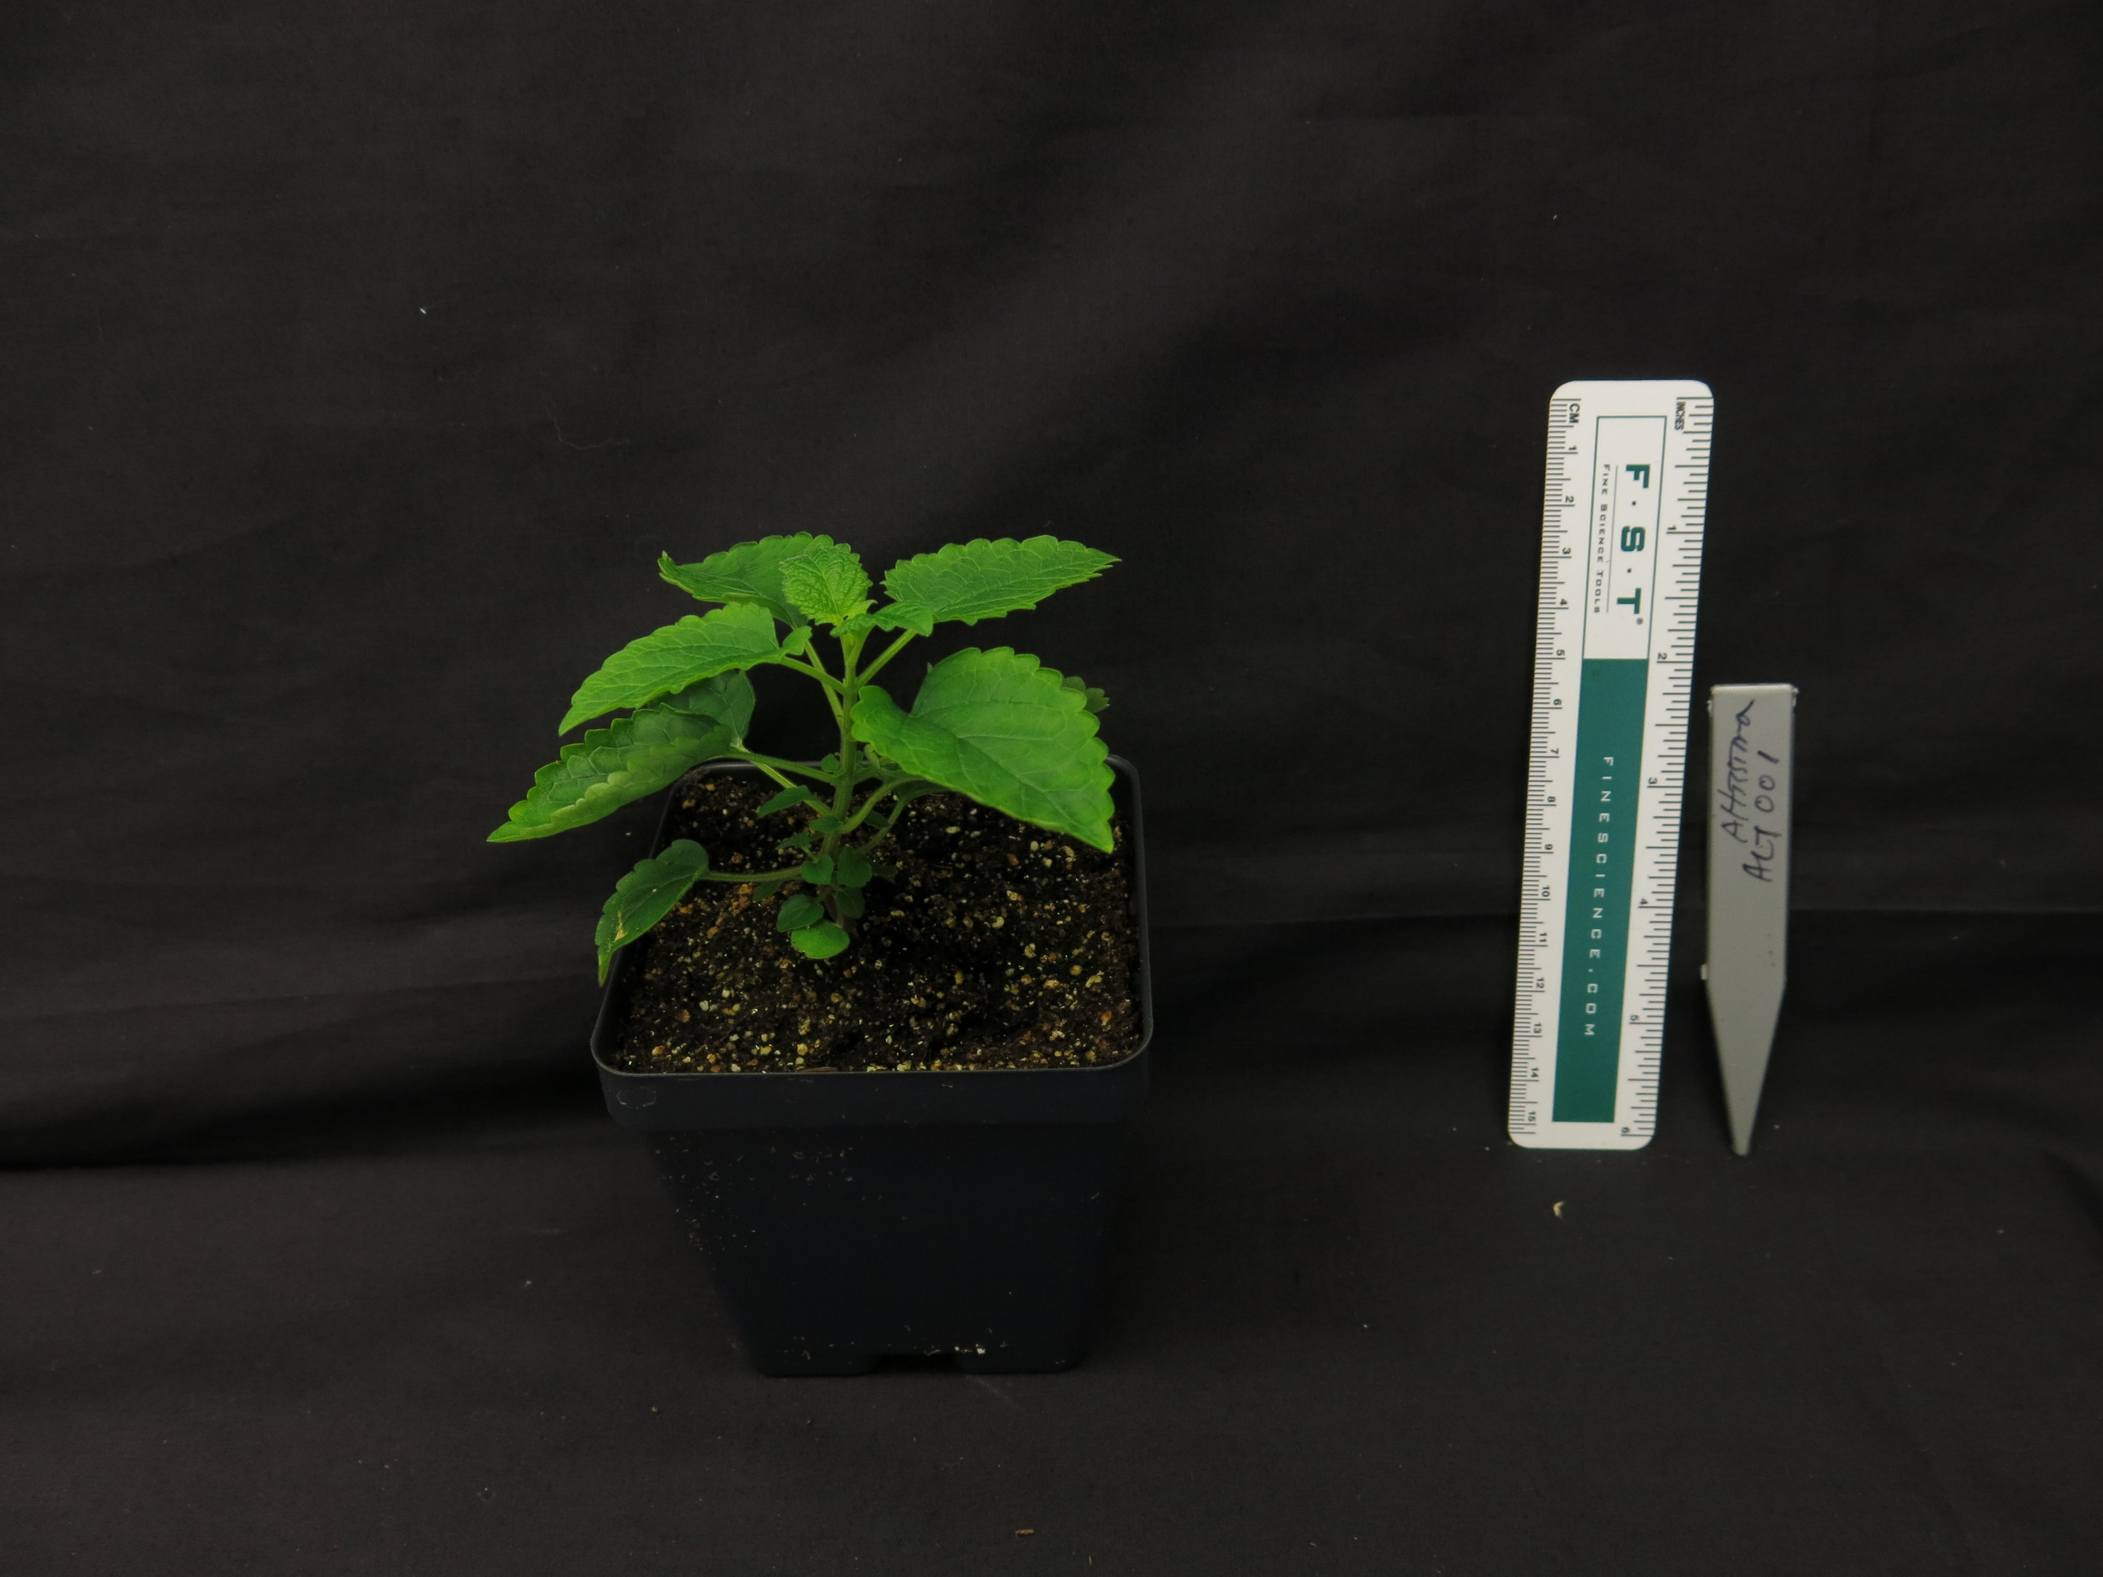
A.
B.
S. baicalensis
S. havanesis
S. arenicola
S. barbata
S. racemosa
S. tournefortii
S. altissima
Figure 1. (A) Maximum likelihood tree inferred from chloroplast genome data for 52 species of Scutellaria. To facilitate downstream analysis, the tree is subdivided into 6 clades. (B) Representative images of 7 species of Scutellaria. Colored circles next to species names indicate the clade which the species belongs to.

Slide 5
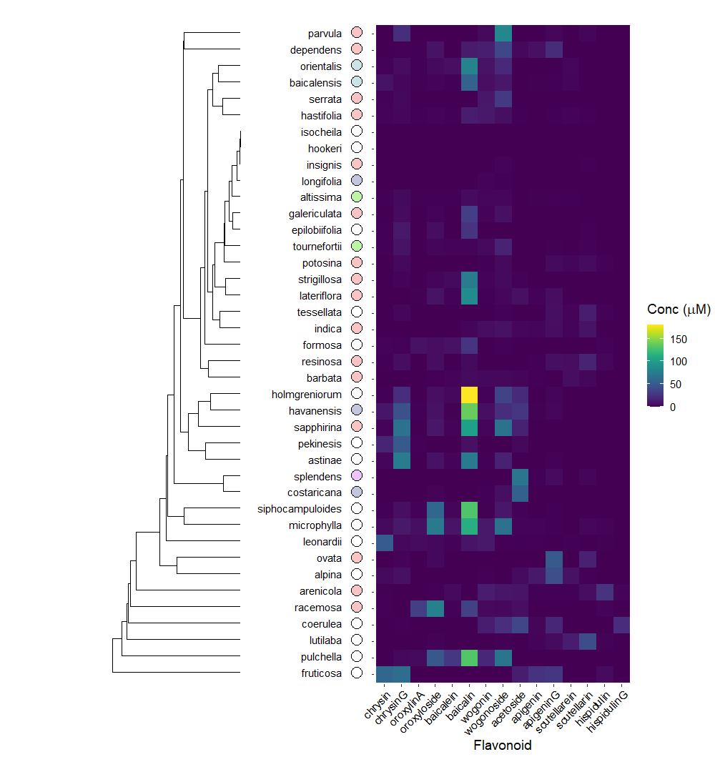
Figure 2. Heatmap of overall flavonoid concentrations measured with High Performance Liquid Chromatography (HPLC) of … species of Scutellaria. Ordering of species was determined by hierarchical clustering based on flavonoid concentration, as illustrated by the dendrogram to the right of the figure. Colored circles next to species names indicate phylogenetic clade, as shown in Figure 1.

Slide 6
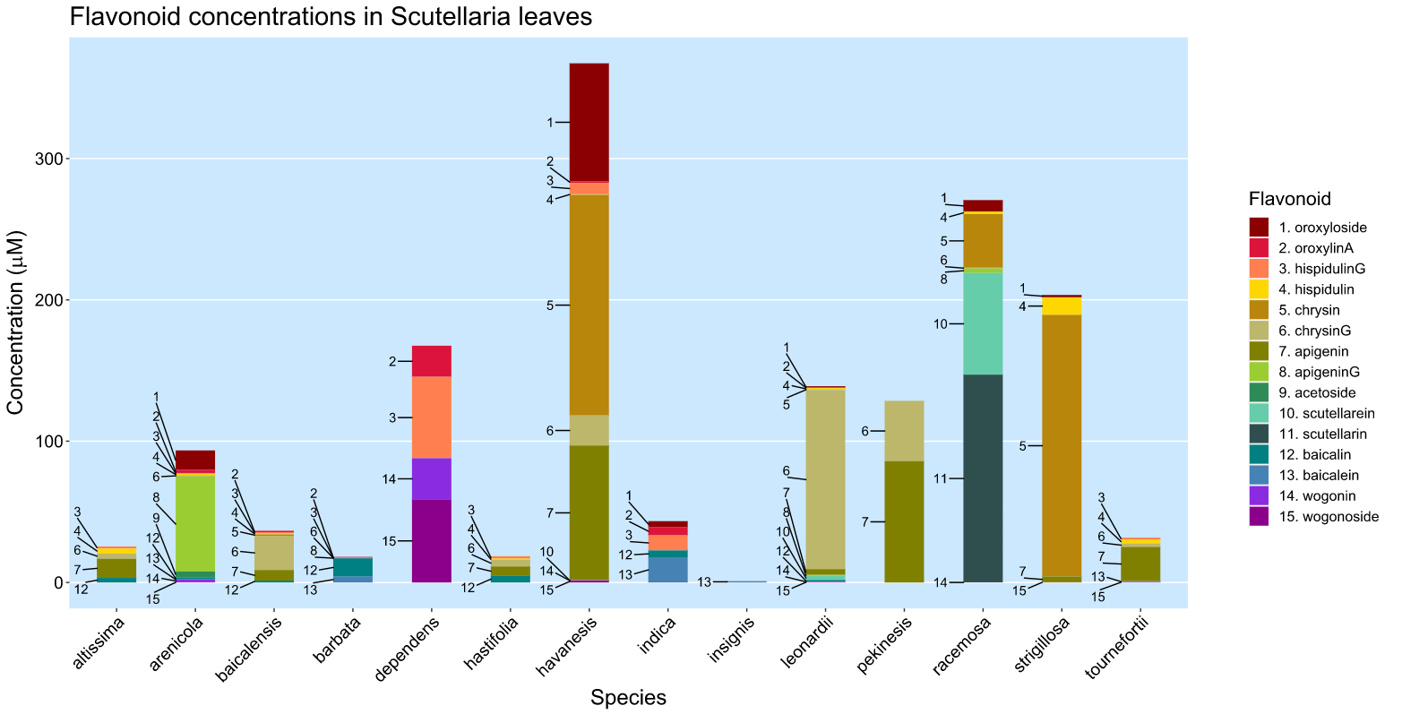
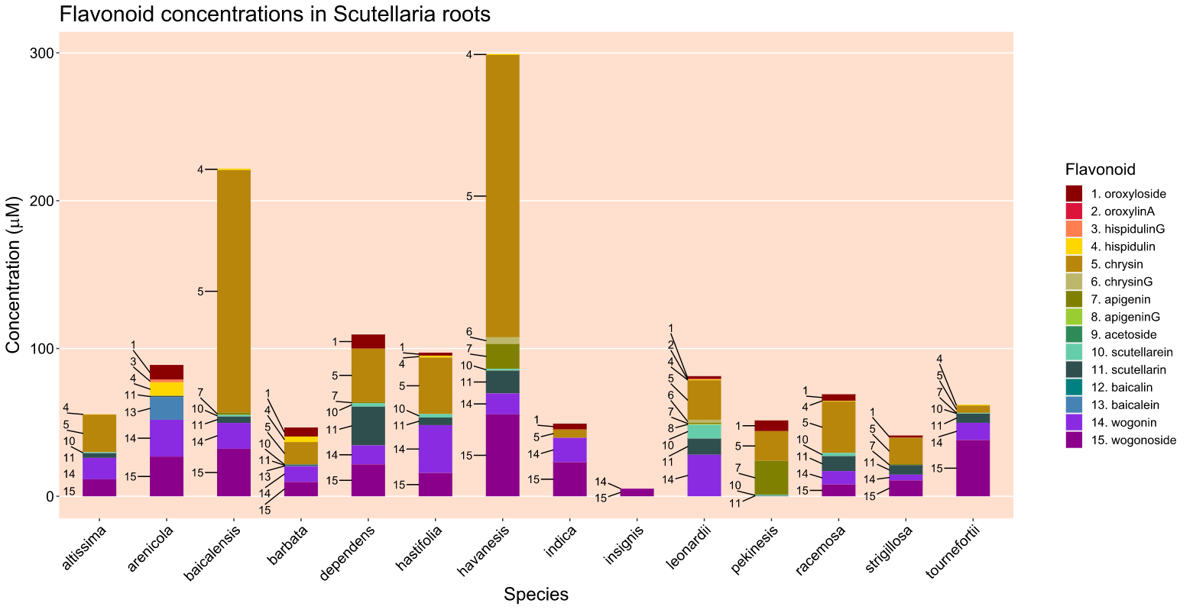
Figure 3.

Slide 7
Table 2. Genome sizes as estimated by flow cytometry.

